Slide 1
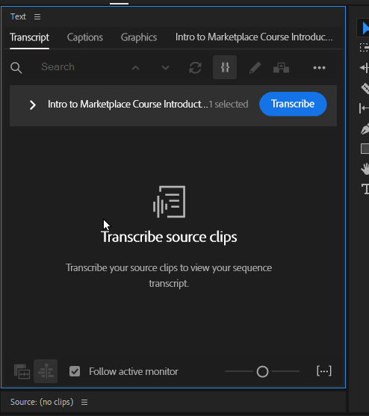
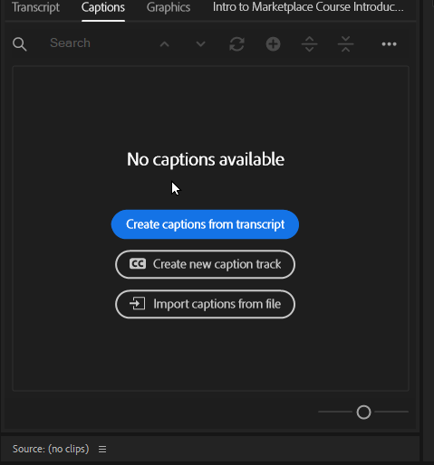
Select your video on the timeline to show the Transcript screen.
You can click Transcribe here
Or click the Captions tab and click the top button

Slide 2
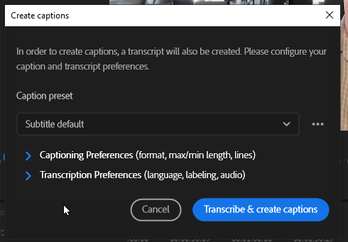
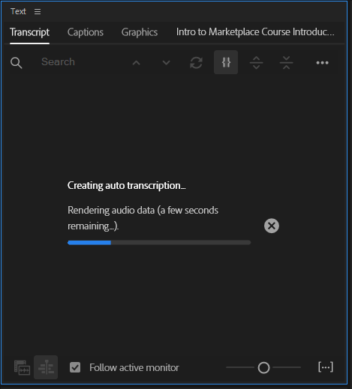
Choose Subtitle default, then click Transcribe & create captions.
You can control format and length under preferences. You can control style, but only if you have done that for this video project previously.

Slide 3
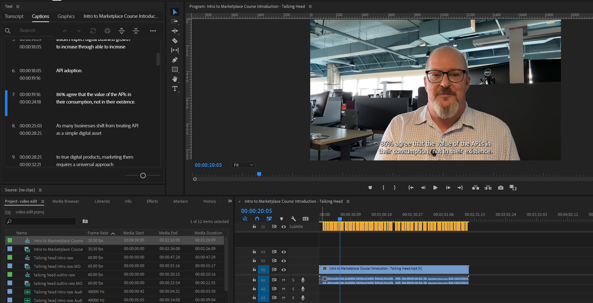
1
2
The captions can be edited by double clicking on them and editing the text
You will also see the Caption track in your timeline editor.

Slide 4
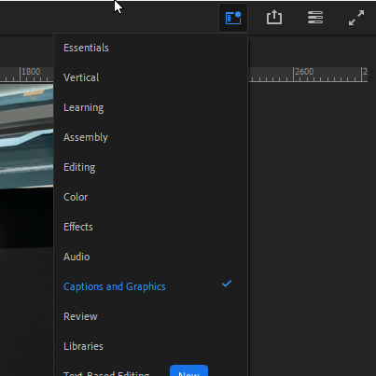
Create a Caption Style
In the menu, top right, click Captions and Graphics

Slide 5
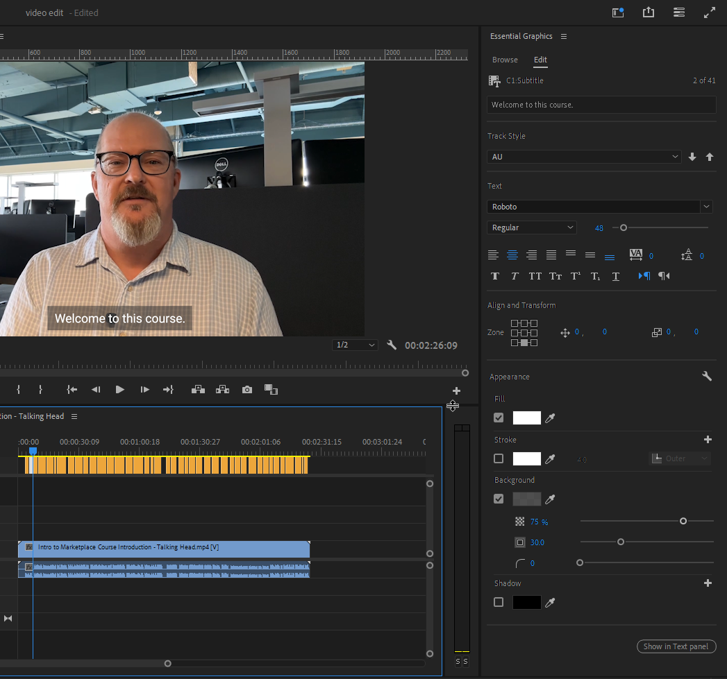
Here you can control the font and it’s appearance, placement of the caption on the screen, fill, stroke, background and Shadow.
Clicking the drop down at Track Style will let you define your own.
NOTE: This style gets saved with the project, not within Adobe Premier.

Slide 6
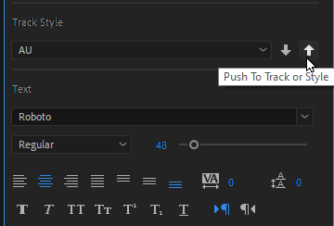
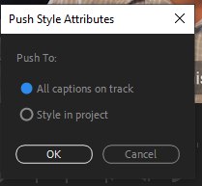
Clicking the up arrow after your track style has been defined will apply the style to your entire track

Slide 7
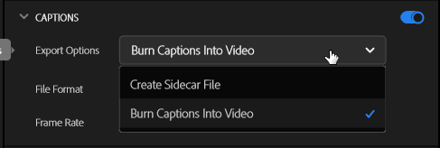
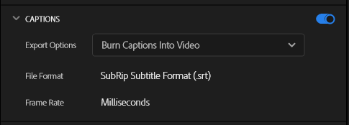
On the export screen under Captions, you can choose to create a Sidecar File. This will be saved in the same location as the video.

